Slide 1
Machine Unlearning
through pipelines
Leonardo Dominici leonardo.dominici@student.uva.nl
Literature Study Presentation
DEEM Lab@BIFOLD

Slide 2
Machine Unlearning
About removing knowledge from trained models
Brand | CPUs | RAM | Buy
Lenovo | 8 | 32 | Yes
Asus | 2 | 4 | No
EvilCorp | 2 | 3 | Yes
Apple | 16 | 16 | Yes
Training set
Trained model
Notes:
Problem definition, first paper

Slide 3
Machine Unlearning
About removing knowledge from trained models
Brand | CPUs | RAM | Buy
Lenovo | 8 | 32 | Yes
Asus | 2 | 4 | No
EvilCorp | 2 | 3 | Yes
Apple | 16 | 16 | Yes
EvilCorp | 2 | 3 | Yes
Forget set
Notes:
Problem definition, first paper

Slide 4
Machine Unlearning
About removing knowledge from trained models
Brand | CPUs | RAM | Buy
Lenovo | 8 | 32 | Yes
Asus | 2 | 4 | No
EvilCorp | 2 | 3 | Yes
Apple | 16 | 16 | Yes
Unlearn
EvilCorp | 2 | 3 | Yes
Notes:
Problem definition, first paper

Slide 5
Machine Unlearning
About removing knowledge from trained models
Brand | CPUs | RAM | Buy
Lenovo | 8 | 32 | Yes
Asus | 2 | 4 | No
EvilCorp | 2 | 3 | Yes
Apple | 16 | 16 | Yes
Unlearn
Unlearnt model
EvilCorp | 2 | 3 | Yes
Notes:
Problem definition, first paper

Slide 6
Machine Unlearning
MU
ML
About removing knowledge from trained models
Brand | CPUs | RAM | Buy
Lenovo | 8 | 32 | Yes
Asus | 2 | 4 | No
EvilCorp | 2 | 3 | Yes
Apple | 16 | 16 | Yes
Unlearn
EvilCorp | 2 | 3 | Yes
Notes:
Problem definition, first paper

Slide 7
Retraining
Machine Unlearning Goal
Unlearnt model should behave like the model retrained on the retain set only [1,2,12,20,22]:
Brand | CPUs | RAM | Buy
Lenovo | 8 | 32 | Yes
Asus | 2 | 4 | No
EvilCorp | 2 | 3 | Yes
Apple | 16 | 16 | Yes
Retain set
Retrained model
Notes:
Problem definition, first paper

Slide 8
Retraining
Machine Unlearning Goal
Unlearning
Unlearnt model should behave like the model retrained on the retain set only [1,2,12,20,22]:
Brand | CPUs | RAM | Buy
Lenovo | 8 | 32 | Yes
Asus | 2 | 4 | No
EvilCorp | 2 | 3 | Yes
Apple | 16 | 16 | Yes
Retain set
Retrained model
Brand | CPUs | RAM | Buy
Lenovo | 8 | 32 | Yes
Asus | 2 | 4 | No
EvilCorp | 2 | 3 | Yes
Apple | 16 | 16 | Yes
Unlearn
EvilCorp | 2 | 3 | Yes
Unlearnt model
Notes:
3 min max

Slide 9




Need for Unlearning
Right to be forgotten[1-3,8,9,12,16,22]:
GDPR, California Consumer Privacy Act
Erease data
Notes:
Problem definition, first paper

Slide 10
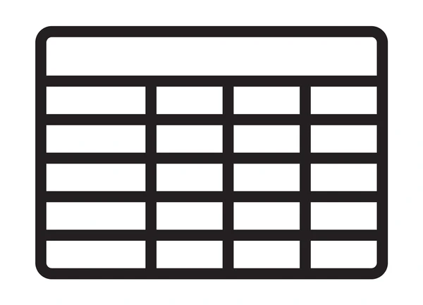
Need for Unlearning
Right to be forgotten[1-3,8,9,12,16,22]:
GDPR, California Consumer Privacy Act
Erease data
Security[1,21,22]:
To avoid poisoning, adversarial and membership inference attacks.
Unlearn
Notes:
Problem definition, first paper

Slide 11








Need for Unlearning
Right to be forgotten[1-3,8,9,12,16,22]:
GDPR, California Consumer Privacy Act
Erease data
Security[1,21,22]:
To avoid poisoning, adversarial and membership inference attacks.
Unlearn
Usability[1,16,22]:
Stop getting recommendations for some products
Recommendation System
Unlearn
Notes:
4:30 min max

Slide 12








Need for Unlearning (2/2)
Biased model
Unbiased model
Doctor
Nurse
Doctor
Nurse
Debiasing[1,8,22]:
Remove/amend some datapoints or features to decrease bias
Unintended memorization[1,8,12]:
Remove data that was not supposed to be part of the training set, or duplicated data
Unlearn Card No.
Item | Price | Card No.
Pan | 29,99€ | 376680816376961
Mouse | 45,00€ | 5063516945005047
Safety[15, 21]:
Remove knowledge about dangerous topics
Chemistry books
Biology papers
Engineering tutorials
Hand sanitizer formula
Chemical weapon handbook
Steam engine explanation
Notes:
Problem definition, first paper

Slide 13
Cross Field Research: Database
MU models can be seen as views generated from the training data as highlighted by Schelter [20].
Incremental View Maintenance and its underlying concepts are used to unlearn and update training data in ML models.
Field | Input | Output
IVM | Source data | View
MU | Training data | ML Model
Relational Algebra (1970s)
Incremental View Maintenance (1980s)
Data Provenance (2000s)
Content regarding this was already included in the following papers.
Interesting tools stemmed from IVM:
Differential Dataflow in 2013 by McSherry[7], used by Schelter [16].
DBSP which implements IVM for SQL queries[6].
Useful to understand what to update and when:
Relies on the Semiring Framework[18].
How-provenance is particularly useful in MU[13,14].
Notes:
6 min

Slide 14
Cross Field Research: Database
MU models can be seen as views generated from the training data as highlighted by Schelter [20].
Incremental View Maintenance and its underlying concepts are used to unlearn and update training data in ML models.
Field | Input | Output
IVM | Source data | View
MU | Training data | ML Model
Relational Algebra (1970s)
Incremental View Maintenance (1980s)
Data Provenance (2000s)
Content regarding this was already included in the following papers.
Main database community contribution to MU in data pipelines.
Differential Dataflow strongly relies on IVM, in 2013 by McSherry[7], used by Schelter [16].
DBSP implements IVM for SQL queries[6]
Schelter and Grafberger show the usefulness of IVM on MU pipelines in Lester [13]
Useful to understand what to update and when:
Green in 2017, summarizes the Semiring Framework to work with provenance [18].
How-provenance is particularly useful in MU[14], also used by Schelter [13]
Notes:
Problem definition, first paper

Slide 15
Cross Field Research: ML
Data-Model Relation (2024)
Influence Functions (2020s)
Sharding (2010s)
Machine Learning itself is the core field from which Machine Unlearning stemmed from.
MU systems are just unlearnable ML systems.
Concept introduced in "Rethinking MU for LLM" [15].
Implicitly used in most MU algorithms [3,16,21,22] to only alter model component affected by unlearnt data.
Originally from statistics, first paper in 1974, brought into ML in 2017.
Used in "MU for Features and Labels" [1,12] in 2023.
Brought in ML with ensemble and federated learning.
Employed in basic MU systems [1,3,12,15].
Notes:
Problem definition, first paper

Slide 16


Cross Field Research: ML
Data-Model Relation (2024)
Influence Functions (2020s)
Sharding (2010s)
X | Y | Influence on classification of 3
 | 3 | +0.5 since correctly labeled and uncommon style
 | 3 | -0.4 since mislabeled
 | 3 | +0.2 since correctly labeled by command style
Machine Learning itself is the core field from which Machine Unlearning stemmed from.
MU systems are just unlearnable ML systems.
Concept introduced in "Rethinking MU for LLM" [15].
Implicitly used in most MU algorithms [3,16,21,22] to only alter model component affected by unlearnt data.
Originally from statistics, first paper in 1974, brought into ML in 2017.
Used in "MU for Features and Labels" [1,12] in 2023.
Brought in ML with ensemble and federated learning.
Employed in basic MU systems [1,3,12,15].
Notes:
Problem definition, first paper

Slide 17
Cross Field Research: ML
Data-Model Relation (2024)
Influence Functions (2020s)
Sharding (2010s)
Starting dataset
Shards
Machine Learning itself is the core field from which Machine Unlearning stemmed from.
MU systems are just unlearnable ML systems.
Weak learners
Final prediction
Concept introduced in "Rethinking MU for LLM" [15].
Implicitly used in most MU algorithms [3,16,21,22] to only alter model component affected by unlearnt data.
Originally from statistics, first paper in 1974, brought into ML in 2017.
Used in "MU for Features and Labels" [1,12] in 2023.
Brought in ML with ensemble and federated learning.
Employed in basic MU systems [1,3,12,15].
Notes:
7:30

Slide 18
Cross Field Research: ML
Data-Model Relation (2024)
Influence Functions (2020s)
Sharding (2010s)
Machine Learning itself is the core field from which Machine Unlearning stemmed from.
MU systems are just unlearnable ML systems.
Concept introduced in "Rethinking MU for LLM" [15].
Implicitly used in most MU algorithms [3,16,21,22] to only alter model component affected by unlearnt data.
Originally from statistics, first paper in 1974, brought into ML in 2017.
Used in "MU for Features and Labels" [1,12] in 2023.
Can be used with convex loss functions [12].
Usage in non-convex loss functions requires computing the inverse of the Hessian matrix and it's often used for unlearning verification [1,12]
Started in 2004 with data parallelism in MapReduce.
Brought in ML with ensemble and federated learning.
Employed in basic MU systems, strongly benefits from complex data preparation pipelines as shown in "Coded MU" [1,3,12,15].
Notes:
Problem definition, first paper

Slide 19
Cross Field Research: Privacy and Security
Differential Privacy (2006)
Adversarial ML(2010s)
Right to be Forgotten (2014)
Privacy and Cybersecurity have been useful in providing tools to evaluate the effectiveness of unlearning.
Pr(Unlearnt model)
ε-unlearning → e^{-ε} ≼
≼ e^{ε}
Pr(Retrained model)
Measure unlearning effectiveness [1,8,12,15].
Identify points worth unlearning [12].
Verifies correct unlearning [1,14,21].
Attacks can be used to quantify DP ε as used in NeurIPS Unlearning competition in 2023[2].
Main driver for the adoption of MU systems as reported in all papers post-GDPR (2018) [1-3,8,9,12,16,22].
Started with Google Search results removal [22].
Notes:
Problem definition, first paper

Slide 20



Cross Field Research: Privacy and Security
Differential Privacy (2006)
Adversarial ML(2010s)
Right to be Forgotten (2014)
Privacy and Cybersecurity have been useful in providing tools to evaluate the effectiveness of unlearning.
Label: safe
+
+
Label: safe
Poisoned training data
Backdoor exploitation possible
Measure unlearning effectiveness [1,8,12,15].
Identify points worth unlearning [12].
Verifies correct unlearning [1,14,21].
Attacks can be used to quantify DP ε as used in NeurIPS Unlearning competition in 2023[2].
Main driver for the adoption of MU systems as reported in all papers post-GDPR (2018) [1-3,8,9,12,16,22].
Started with Google Search results removal [22].

Slide 21
Cross Field Research: Privacy and Security
Differential Privacy (2006)
Adversarial ML(2010s)
Right to be Forgotten (2014)
Privacy and Cybersecurity have been useful in providing tools to evaluate the effectiveness of unlearning.
Label: safe
+
+
Label: safe
Poisoned training data
Backdoor exploitation possible
Label: safe
+
+
Label: RUN!
Forget set
Backdoor exploitation prevented
Measure unlearning effectiveness [1,8,12,15].
Identify points worth unlearning [12].
Verifies correct unlearning [1,14,21].
Attacks can be used to quantify DP ε as used in NeurIPS Unlearning competition in 2023[2].
Main driver for the adoption of MU systems as reported in all papers post-GDPR (2018) [1-3,8,9,12,16,22].
Started with Google Search results removal [22].
Notes:
8:30

Slide 22
Cross Field Research: Privacy and Security
Differential Privacy (2006)
Adversarial ML(2010s)
Right to be Forgotten (2014)
Privacy and Cybersecurity have been useful in providing tools to evaluate the effectiveness of unlearning.
Label: safe
+
+
Label: safe
Poisoned training data
Backdoor exploitation possible
Label: safe
+
+
Label: RUN!
Forget set
Backdoor exploitation prevented
Allows measurement of approximate unlearning by comparing the unlearnt and retrained model probability distributions[1,8,12,15].
Let's us understand when unlearning a point has significant effects [12].
Used to evaluate actual unlearning of datapoints with membership inference attacks, backdoor attacks, adversarial training[1,14,21].
Attacks can be used to quantify DP ε as used in NeurIPS Unlearning competition in 2023[2].
The first and main driver for the adoption of MU systems as reported in all papers post-GDPR (2018) [1-3,8,9,12,16,22].
Started with Google Search results removal [22].
Notes:
Problem definition, first paper

Slide 23
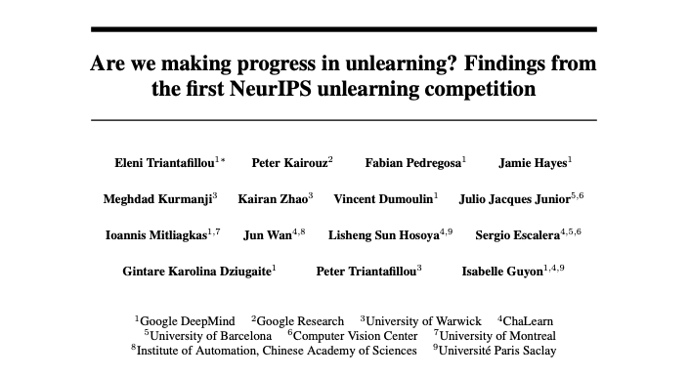
MU Examples
Erease and Repair
Sharding
Finetune
Notes:
Problem definition, first paper

Slide 24
MU Examples
Erase and Repair:
Extremely popular in “Are we making progress in unlearning?” [2].
First degrades the model to then fine-tune it on the retain set.
Sharding:
Split data in shards distributed to weak learners, then retrain only the learners whose shards are affected by the updates[3].
Finetune:
Finetuning on retain set or on the whole set with randomized label for the forget set. Passively unlearns [2].
Notes:
Problem definition, first paper

Slide 25
How to Evaluate MU
"Are we making progress in unlearning?" [2] is one of the most interesting papers dealing with the issue of quantifying the quality of MU systems.
Unlearning time
Forgetting quality
Post-unlearning utility
(ε,δ)-unlearning
Relearn time
Adversarial ML
Influence functions
Model parameters distance
Notes:
(ε,δ)-unlearning gives an overview but doesn't show individual datapoints behaviour, works on the model probability distribution: computes every forget set datapoint probability distribution and find (ε,δ) between the unlearnt and retrained model, then bins and aggregate it to show a whole forget set view of it. Use attacks to find the False Negative and Positive rates, use multiple attackers and pick the best performing attacker, and that defines the (ε,δ)
Adversarial ML includes backdoor attacks and feature injection: flag data to be unlearnt with a feature, verify that after unlearnt that feature is inserted into a weight with weight=0

Slide 26
What About the Pipelines?
Notes:
10 minutes

Slide 27
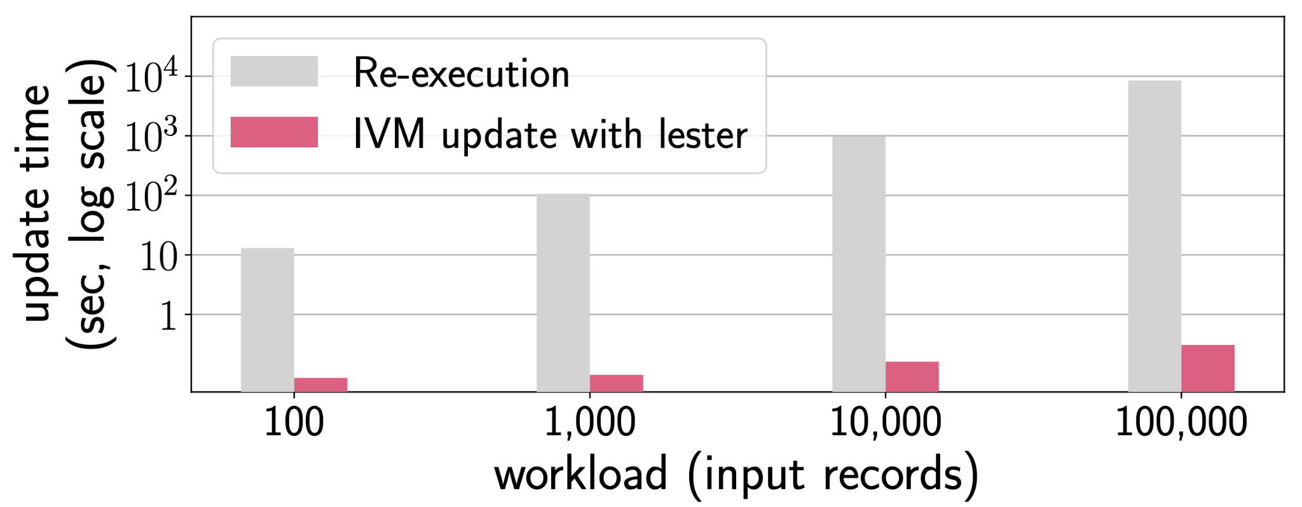

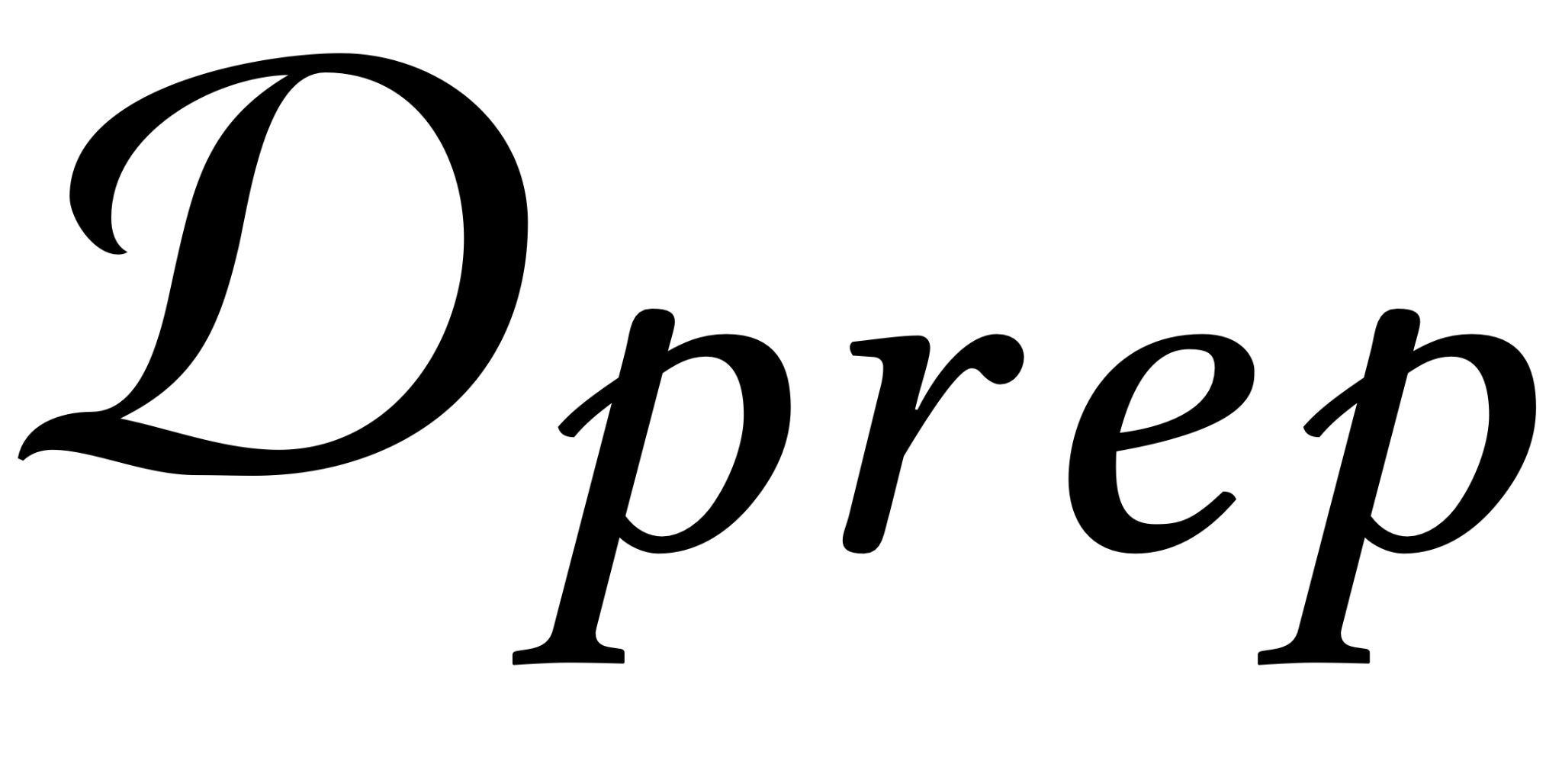

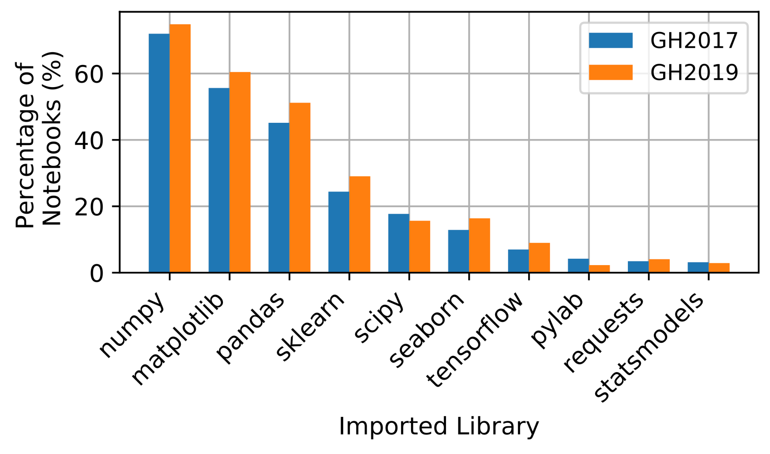
Lester, Schelter 2024 [13]
Makes pipelines declarative via LLM and allows them to be unlearnt. The end model is also unlearnt via first-order update.
Estimator/Transformers
(X;y)
Relational Algebra
𝜙𝐴₁,..,𝜙𝐴_{n}
How-provenance
Column provenance
Column provenance
First order update
Relies on Pandas-like dataframe API and extended Scikit estimator/transformer. These are already the de-facto standard according to “Data Science Through the Looking Glass” [5].
Notes:
Pipelines are not in great shape, just think about Google text completion suggesting credit card numbers and Facebook not being able to track the dataflow of personal information

Slide 28
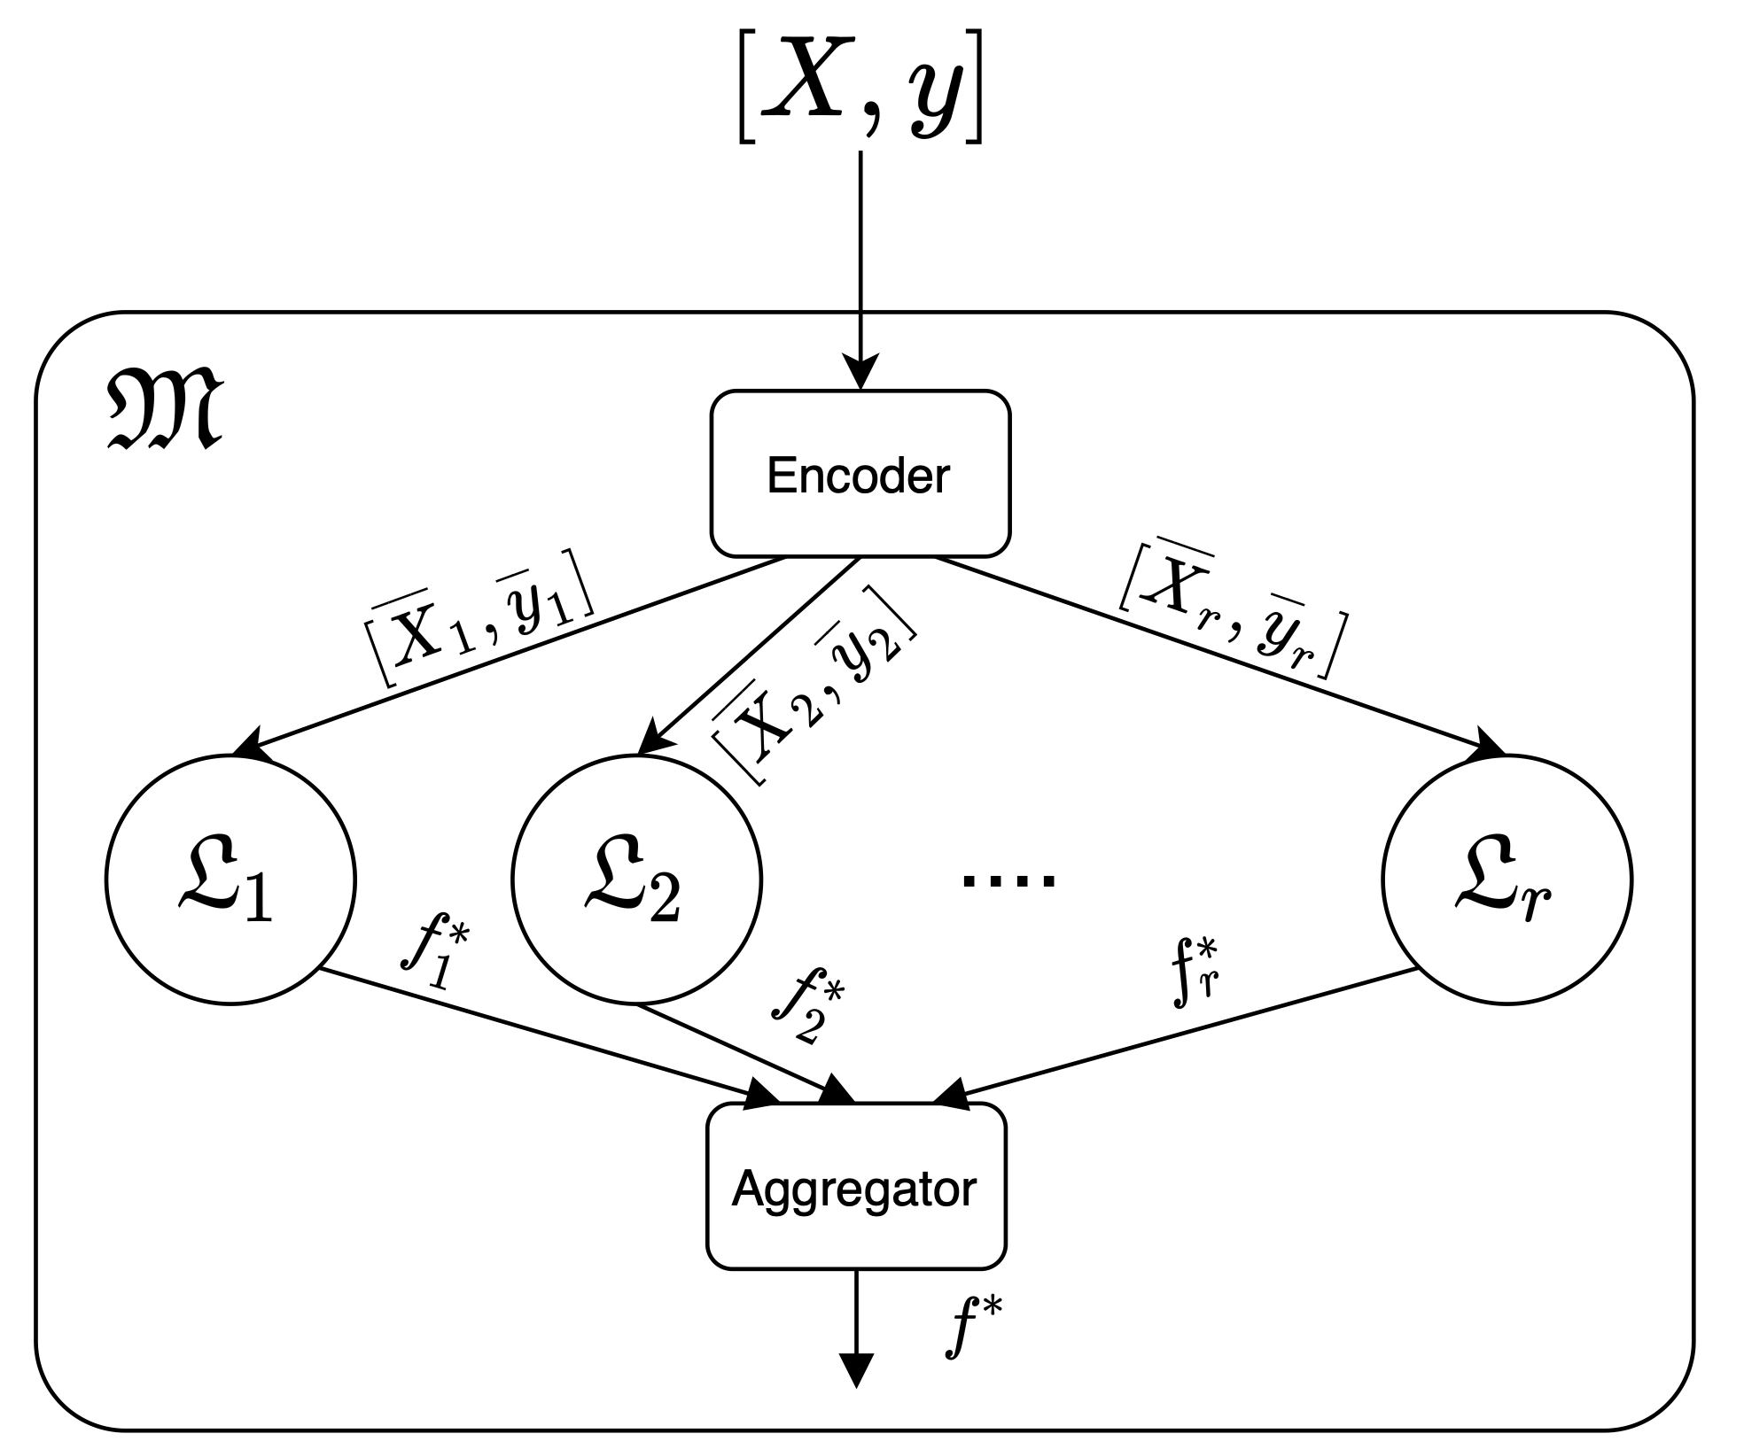
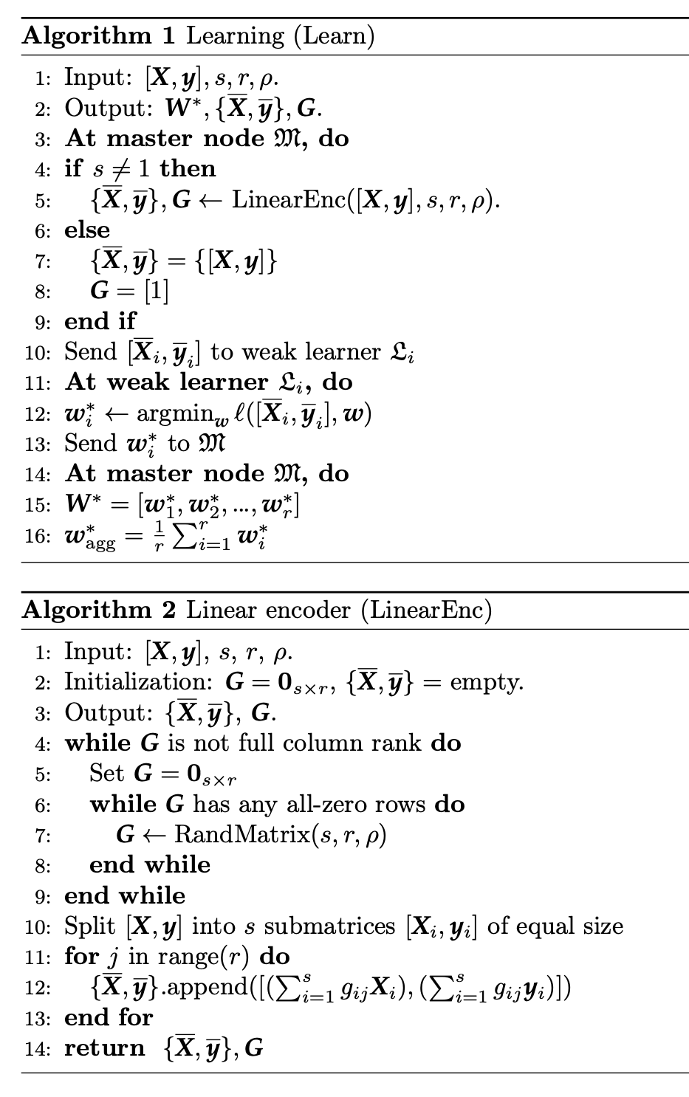
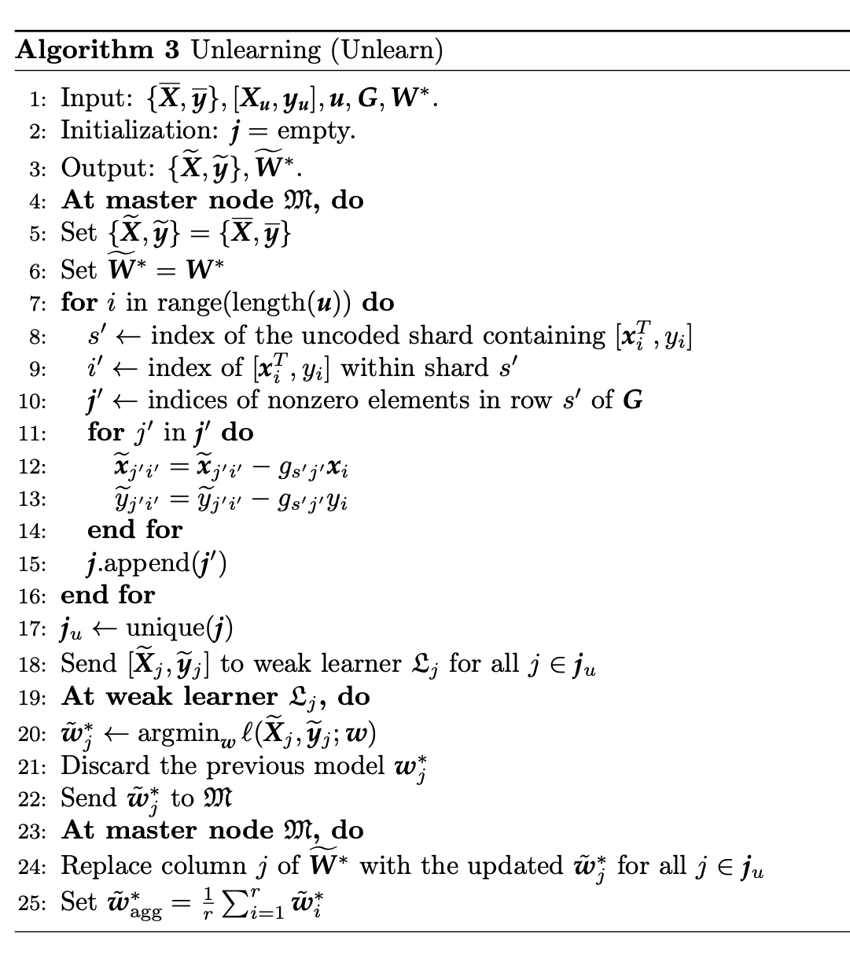
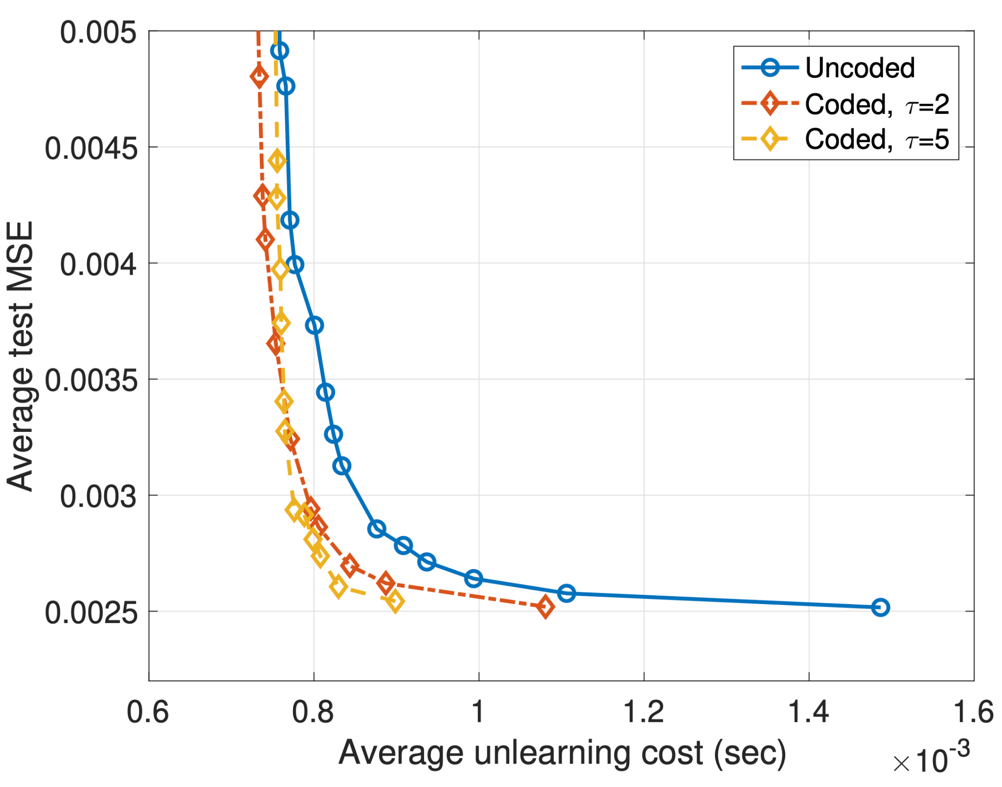
Coded Machine Unlearning, Aldaghri 2020 [3]
Shows the benefit of non-trivial data engineering pipelines in a MU scenario.
Sub-obtimal implementation with non-declarative code and manual unlearning implementation.
Highlights the benefits of Data Engineering even in unlearning scenarios
Unlearning
Error prone
Notes:
13:00 min max

Slide 29
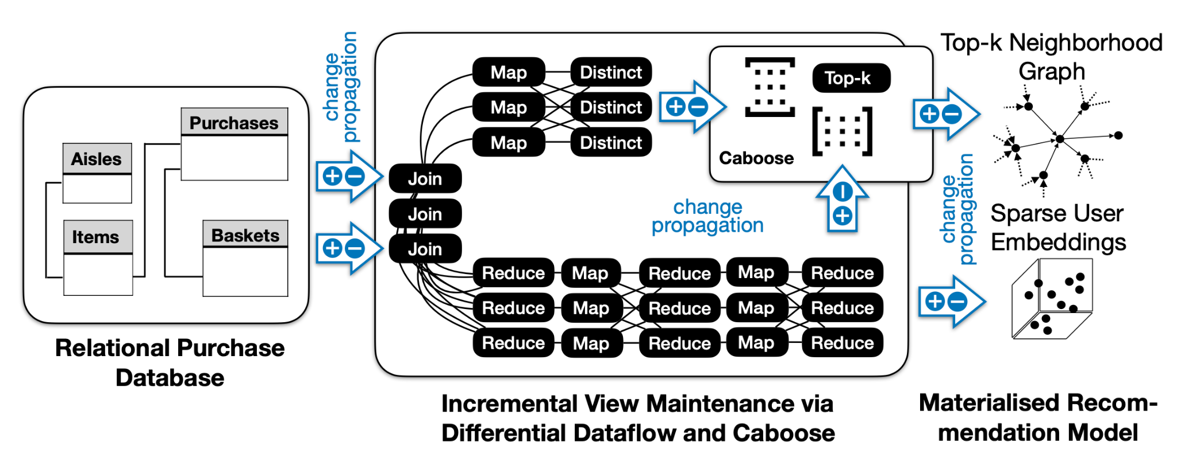
Snapcase regain control over your predictions with low-latency machine unlearning, Schelter 2024 [16]
Data preparation pipeline relies on:
Differential Dataflow to maintain the data preparation pipeline.
Caboose to maintain a complex top-k aggregation obtained by a matrix multiplication.
Runtime computation of the recommendation via TIFU based on Caboose result.
Notes:
14:00 MAX

Slide 30
Evolution from "Towards Making Systems Forget with MU", 2015
Evaluation moved to a more complex representation: it was only forgetness completeness and timeliness.
Major driver changed: was benefitting the user by having one more feature and the provider by getting more profit opportunities.
Example relies on Statistical Query learning which is not very popular today.
Notes:
Problem definition, first paper

Slide 31
Conclusion
Pipelines are often disregarded and not systematically dealt with.
Most of the effort is focused on unlearning the models.
Even less regard to pipelines in LLM models where the forget set is harder to define.
Erease-retrain and missing evaluation standard are symptomatic of how little we know.
Lack of standard evaluation metric, let alone complete benchmark, which should be coupled witht the unlernt model.
Notes:
The last one is like in snapcase, a part of TIFU is implemented in differential dataflow, namely the weight decay part with multiple joins, makes it hard to develop a tool for pipeline unlearning

Slide 32
Questions
Notes:
Problem definition, first paper

Slide 33
Citations
[1] T. T. Nguyen, T. T. Huynh, Z. Ren, P. L. Nguyen, A. W.-C. Liew, H. Yin, and Q. V. H. Nguyen, “A survey of machine unlearning,” 2024.
[2] E. Triantafillou, P. Kairouz, F. Pedregosa, J. Hayes, M. Kurmanji, K. Zhao, V. Du-moulin, J. J. Junior, I. Mitliagkas, J. Wan, L. S. Hosoya, S. Escalera, G. K. Dziugaite, P. Triantafillou, and I. Guyon, “Are we making progress in unlearning? findings from the first neurips unlearning competition,” 2024.
[3] N. Aldaghri, H. Mahdavifar, and A. Beirami, “Coded machine unlearning,” IEEE Access, vol. 9, p. 88137–88150, 2021.
[4] S. Grafberger, P. Groth, J. Stoyanovich, and S. Schelter, “Data distribution debugging in machine learning pipelines,” The VLDB Journal, vol. 31, p. 1103–1126, Jan.2022.
[5] F. Psallidas, Y. Zhu, B. Karlas, J. Henkel, M. Interlandi, S. Krishnan, B. Kroth,V. Emani, W. Wu, C. Zhang, M. Weimer, A. Floratou, C. Curino, and K. Karanasos, “Data science through the looking glass: Analysis of millions of github notebooks and ml.net pipelines,” SIGMOD Rec., vol. 51, p. 30–37, July 2022.
[6] M. Budiu, T. Chajed, F. McSherry, L. Ryzhyk, and V. Tannen, “Dbsp: Automatic incremental view maintenance for rich query languages,” Proc. VLDB Endow., vol. 16, p. 1601–1614, Mar. 2023.
[7] F. McSherry, D. G. Murray, R. Isaacs, and M. Isard, “Differential dataflow,” in Sixth Biennial Conference on Innovative Data Systems Research, CIDR 2013, Asilomar, CA, USA, January 6-9, 2013, Online Proceedings, www.cidrdb.org, 2013.
[8] T. Shaik, X. Tao, H. Xie, L. Li, X. Zhu, and Q. Li, “Exploring the landscape of machine unlearning: A comprehensive survey and taxonomy,” IEEE Transactions on Neural Networks and Learning Systems, pp. 1–21, 2024.
[9] S. Schelter, S. Grafberger, and T. Dunning, “Hedgecut: Maintaining randomised trees for low-latency machine unlearning,” in Proceedings of the 2021 International Conference on Management of Data, SIGMOD ’21, (New York, NY, USA), p. 1545–1557, Association for Computing Machinery, 2021.
[10] T. Griffin and L. Libkin, “Incremental maintenance of views with duplicates,” in Proceedings of the 1995 ACM SIGMOD International Conference on Management of Data, SIGMOD ’95, (New York, NY, USA), p. 328–339, Association for Computing Machinery, 1995.
[11] T. Griffin and L. Libkin, “Incremental maintenance of views with duplicates,” SIGMOD Rec., vol. 24, p. 328–339, May 1995.
[12] A. Warnecke, L. Pirch, C. Wressnegger, and K. Rieck, “Machine unlearning of features and labels,” 2023.
[13] S. Schelter and S. Grafberger, “Messy code makes managing ml pipelines difficult? just let llms rewrite the code!,” 2024.
[14] J. Cheney, L. Chiticariu, and W.C. Tan, “Provenance in databases: Why, how, and where,” Found. Trends Databases, vol. 1, p. 379–474, Apr. 2009.
[15] S. Liu, Y. Yao, J. Jia, S. Casper, N. Baracaldo, P. Hase, Y. Yao, C. Y. Liu, X. Xu, H. Li, K. R. Varshney, M. Bansal, S. Koyejo, and Y. Liu, “Rethinking machine unlearning for large language models,” 2024.
[16] S. Schelter, S. Grafberger, and M. de Rijke, “Snarcase regain control over your predictions with low-latency machine unlearning,” Proc. VLDB Endow., vol. 17, p. 4273–4276, Aug. 2024.
[17] S. Amershi, A. Begel, C. Bird, R. DeLine, H. Gall, E. Kamar, N. Nagappan, B. Nushi, and T. Zimmermann, “Software engineering for machine learning: A case study,” in 2019 IEEE/ACM 41st International Conference on Software Engineering: Software Engineering in Practice (ICSE-SEIP), pp. 291–300, 2019.
[18] T. J. Green and V. Tannen, “The semiring framework for database provenance,” in Proceedings of the 36th ACM SIGMOD-SIGACT-SIGAI Symposium on Principles of Database Systems, PODS ’17, (New York, NY, USA), p. 93–99, Association for Computing Machinery, 2017.
[19] S. B. R. Chowdhury, K. M. Choromanski, A. Sehanobish, K. A. Dubey, and S. Chaturvedi, “Towards scalable exact machine unlearning using parameter’efficient fine-tuning,” in The Thirteenth International Conference on Learning Representations, 2025.
[20] S. Schelter, “Towards efficient machine unlearning via incremental view maintenance.”
[21] J. Łucki, B. Wei, Y. Huang, P. Henderson, F. Tramèr, and J. Rando, “An adversarial perspective on machine unlearning for ai safety,” 2025.
[22] Y. Cao and J. Yang, “Towards making systems forget with machine unlearning,” in IEEE Symposium on Security and Privacy, pp. 463–480, IEEE Computer Society, 2015

